Slide 1
EXPLORATORY DATA ANALYSIS OF THE DANISH HOUSING MARKET: A DATA-DRIVEN APPROACH TO PROPERTY PRICE DETERMINANTS
AKINLADE AYOMIKUN DORCAS
13TH JULY, 2026

Slide 2
Table of Contents
Abstract
Introduction
Aim and Objectives
Literature Review
Methodology

Slide 3
Table of Contents
Solution to Research Questions
Key Findings
Limitations
Conclusion and recommendations
References

Slide 4
ABSTRACT
This study explores the Danish housing market using Exploratory Data Analysis (EDA) techniques in Python.
The dataset was cleaned, transformed, and analyzed to identify patterns in housing prices across different regions, property types, property ages, and construction periods.
Various statistical summaries and visualizations including bar charts, box plots, histograms, line plots, pie charts, and heatmaps were used to answer fifteen research questions.
The findings show that housing prices are significantly influenced by location, property type, property size, age, and construction decade.
The study demonstrates how data analytics can provide valuable insights for buyers, sellers, investors, and policymakers.

Slide 5
INTRODUCTION
The housing market is an important sector of every economy. House prices are influenced by several factors such as location, property size, property type, age of the building, and market demand.
Exploratory Data Analysis (EDA) provides an effective way of discovering hidden trends, relationships, and patterns within housing datasets before applying predictive models.
This study focuses on analyzing the Danish housing market using Python and data visualization techniques.

Slide 6
Aim of the Study
The aim of the study is to perform an Exploratory Data Analysis of the Danish Housing Market.

Slide 7
Objectives
To clean and prepare the dataset.
To identify missing values and outliers.
To analyze housing prices across regions.
To compare different property types.
To investigate negotiation outcomes.
To study the effect of property age.
To examine housing price trends using visualization techniques.

Slide 8
Literature Review
Housing markets have attracted extensive academic interest because of their importance to economic growth, wealth creation, and social welfare.
According to Tukey, EDA allows analysts to "listen to the data" before drawing conclusions.
Research by Rosen (1974) introduced the Hedonic Pricing Model, explaining that house prices are determined by bundles of characteristics rather than individual features.
Relatively fewer studies focus exclusively on comprehensive exploratory analysis.

Slide 9
Dataset
Danish Housing Dataset
Multiple regions
Various property types
Purchase prices
Offer prices Size (sqm)
Construction year

Slide 10
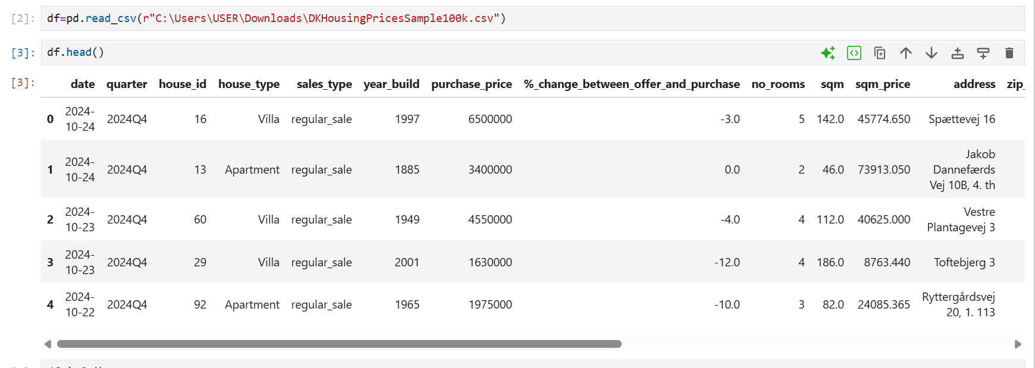
Dataset

Slide 11
Tools Used
Python
Pandas
NumPy
Matplotlib
Seaborn
Jupyter Notebook

Slide 12
Methodology
Data Collection
Data Cleaning
Feature Engineering
Exploratory Data Analysis
Visualization
Interpretation

Slide 13
What is the structure of the dataset?
Analysis
The dataset structure was examined using .shape, .info(), and .isnull().sum() to determine the number of rows, columns, data types, and missing values.
Findings
Dataset contains both numerical and categorical variables.
Numerical variables include purchase price, offer price, and property size.
Categorical variables include region and property type.
Missing values were identified before analysis.
Conclusion
The dataset was well structured and suitable for exploratory analysis after identifying missing values.

Slide 14
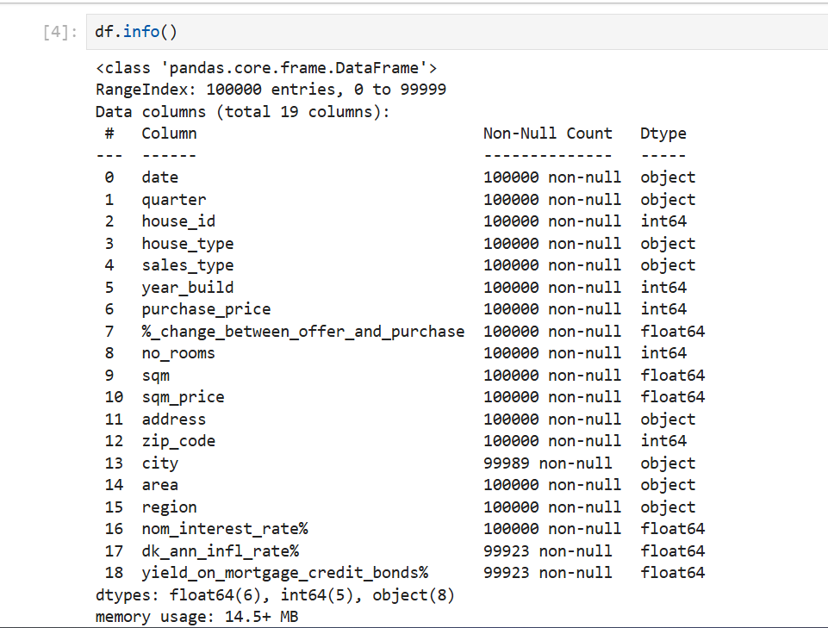

Slide 15
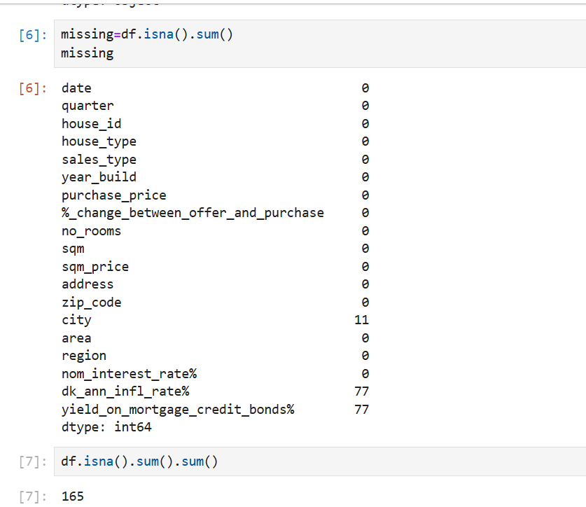

Slide 16
How were missing values handled and data types converted?
Analysis
Numerical missing values were replaced using median values.
Categorical missing values were filled using the mode.
Date columns were converted into appropriate datetime format.
Conclusion
The cleaned dataset became suitable for reliable statistical analysis.

Slide 17
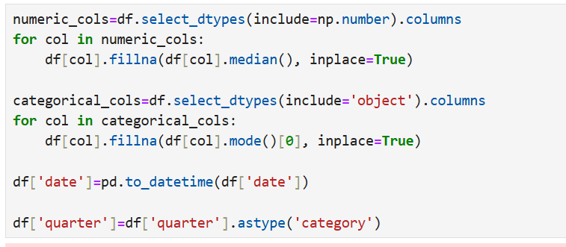

Slide 18
Which outliers exist?
Analysis
The IQR method was applied to:
Purchase Price
Property Size
Price per Square Meter
Findings
Several extreme values were detected, especially among luxury homes.
Conclusion
Outliers mainly represented expensive properties rather than data errors.

Slide 19
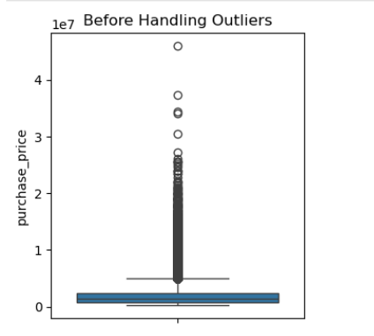

Slide 20
How were outliers handled?
Analysis
Outliers were investigated before deciding whether to remove or retain them.
Findings (Capping was Used)
Genuine luxury properties were retained.
Obvious errors would be removed.
Extreme observations were considered part of the housing market.
Conclusion
Retaining valid outliers preserved important market information. Hence, capping is used.

Slide 21
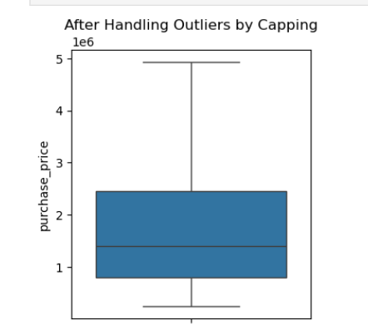

Slide 22
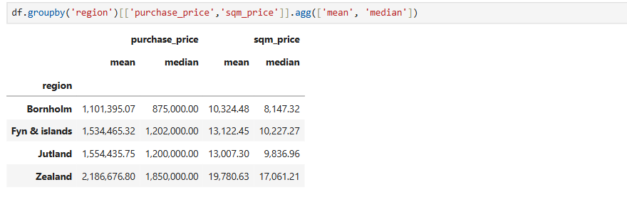
Average and Median Housing Prices by Region

Slide 23
Average and Median Housing Prices by Region
Findings
Housing prices differ significantly across regions.
Zealand has the highest average prices and hence, the most expensive.
Bornholm is the most affordable.
Conclusion
Region is one of the strongest determinants of housing prices.

Slide 24
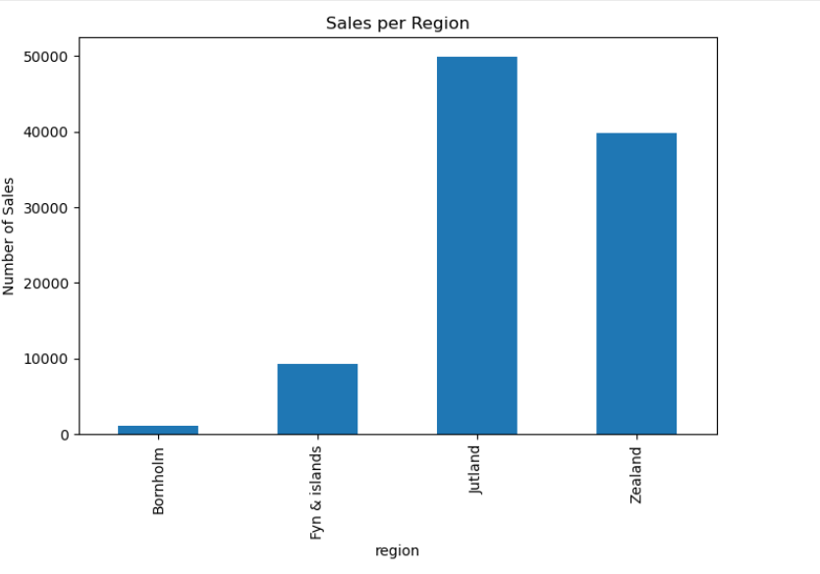
Sales Activity Across Regions

Slide 25
Sales Activity Across Regions
Findings
Sales volume varies across regions.
High sales indicate active housing markets.
Low sales may indicate lower demand.
Jutland shows high market activity.
Bornholm shows high market activity.
Conclusion
Housing market activity differs considerably between Danish regions.

Slide 26
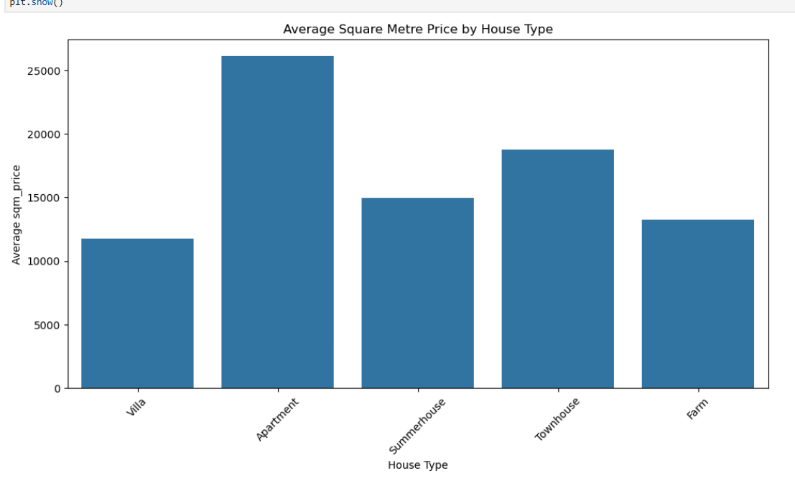
Property Type Comparison

Slide 27
Property Type Comparison
Findings
Apartments command higher prices.
Villas are relatively cheaper.
Conclusion
Property type significantly influences housing prices.

Slide 28
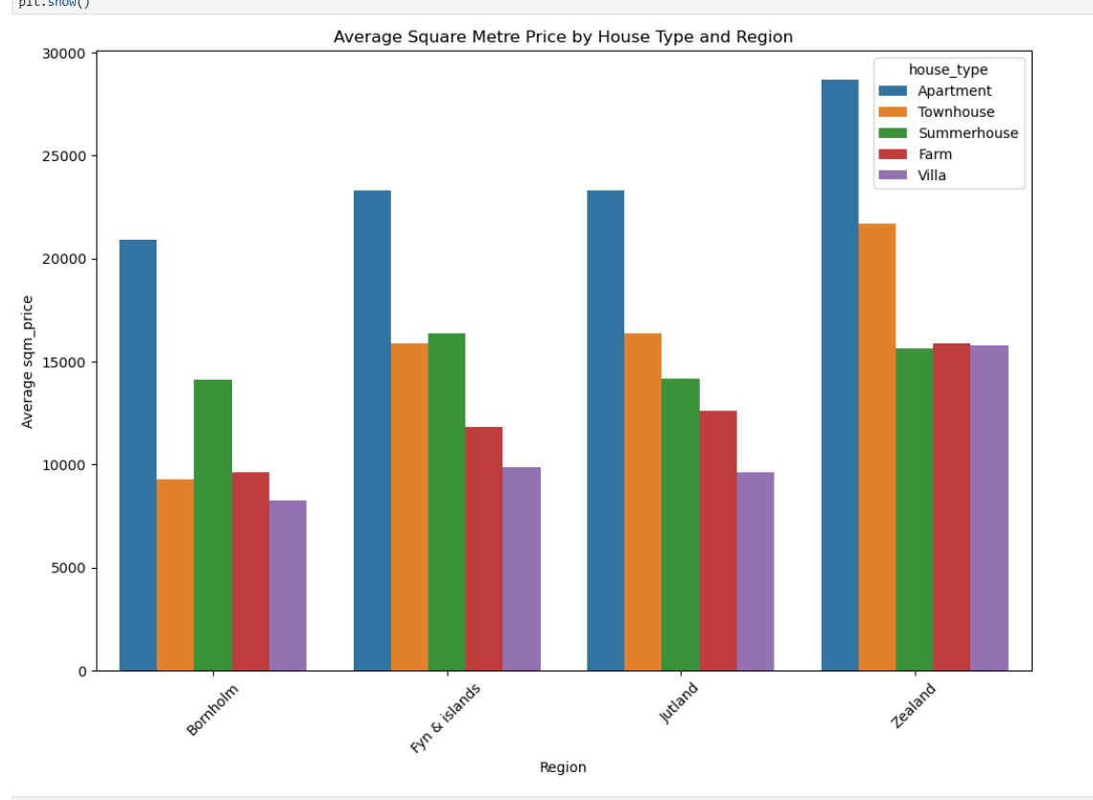

Slide 29
Property Type Comparison Across Regions
Findings
Apartments generally command higher prices.
Villas are relatively cheaper.
Farms, townhouses and summerhouses show distinct pricing patterns.
Conclusion
Property type significantly influences housing prices.

Slide 30
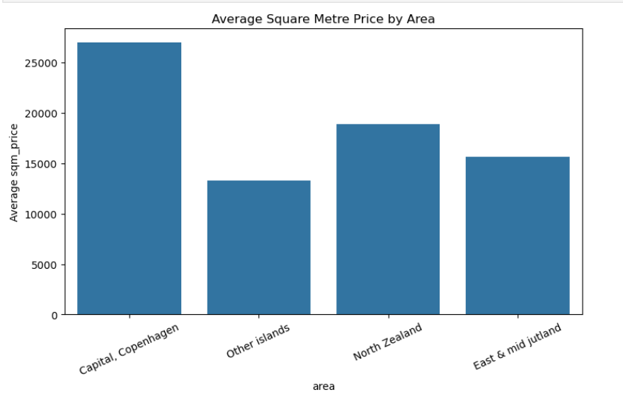
Capital Copenhagen vs Rest of Zealand and East and Mid of Jutland

Slide 31
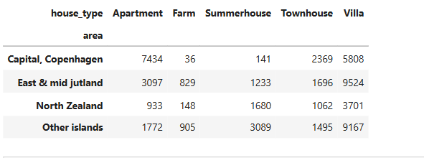
Capital Copenhagen vs Rest of Zealand and East and Mid of Jutland

Slide 32
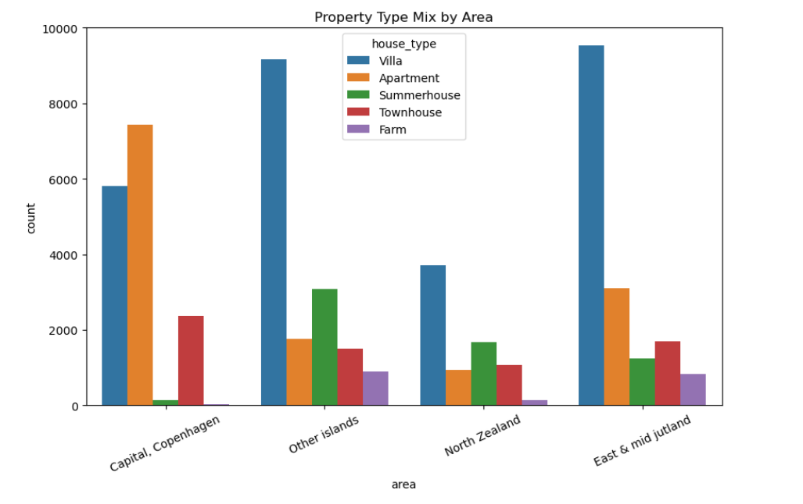

Slide 33
Capital Copenhagen vs Rest of Zealand and East and Mid of Jutland
Findings
Copenhagen records the highest price per square meter.
Properties are generally smaller but more expensive.
Other regions offer larger properties at lower prices.
Conclusion
Location greatly affects price per square meter.

Slide 34
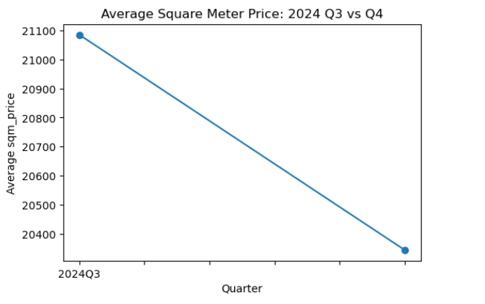
Quarter 3 vs Quarter 4 Analysis of Average Square Meter Price

Slide 35
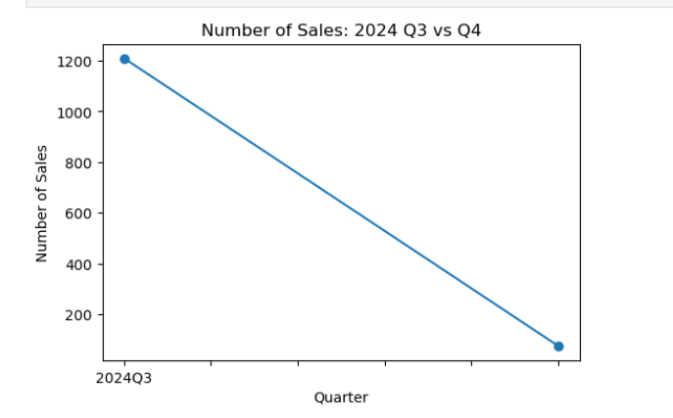
Quarter 3 vs Quarter 4 Analysis of Number of Sales

Slide 36
Quarter 3 vs Quarter 4 Analysis
Findings
Average prices changed by decreasing from Quarter 3 to Quarter 4.
Sales volume also fluctuated by decreasing from Quarter 3 to Quarter 4.
Seasonal effects were observed.
Conclusion
Housing prices and market activity vary over time.

Slide 37
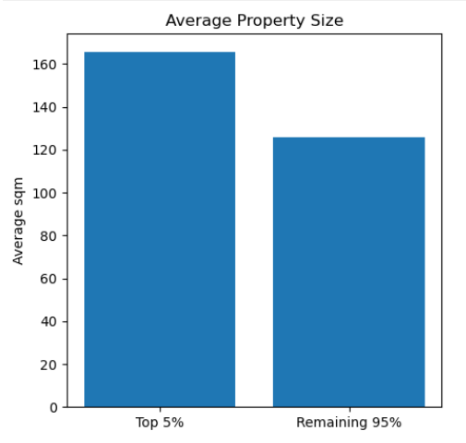
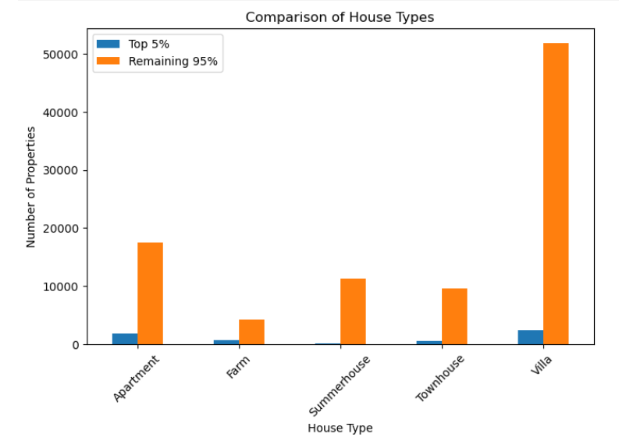
Top 5% Most Expensive Properties

Slide 38
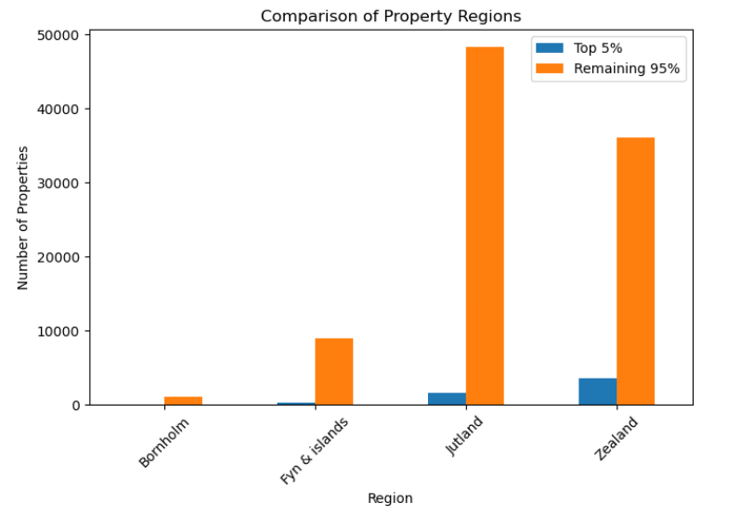
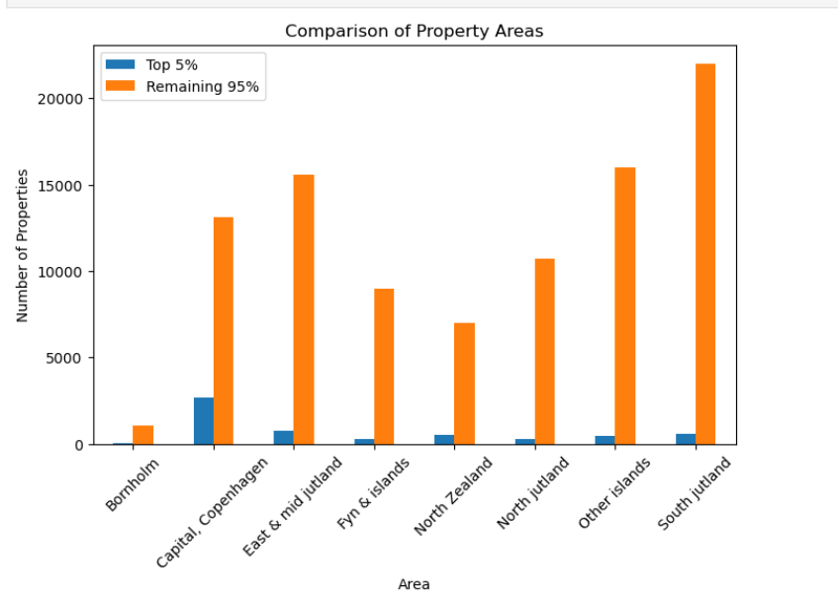
Top 5% Most Expensive Properties

Slide 39
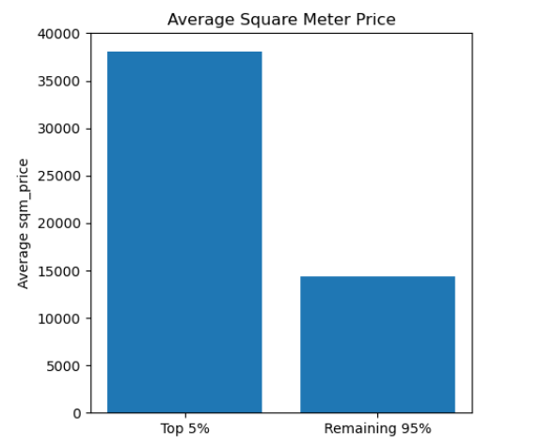
Top 5% Most Expensive Properties

Slide 40
Top 5% Most Expensive Properties
Findings
Luxury properties generally have:
Larger sizes
Premium locations
Higher price per square meter
Mostly villas
Conclusion
Luxury homes possess unique characteristics that distinguish them from ordinary properties.

Slide 41
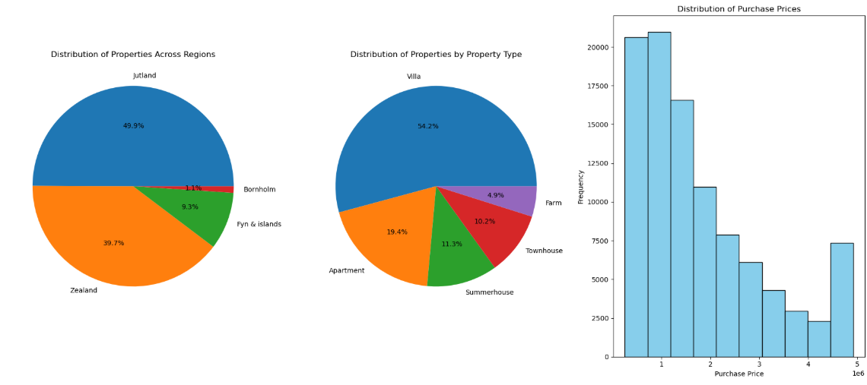
Distribution of Housing Data

Slide 42
Distribution of Housing Data
Findings
Villas dominate the dataset.
Some regions contain more observations.
Housing prices are positively skewed.
Conclusion
The dataset reflects a diverse housing market.

Slide 43
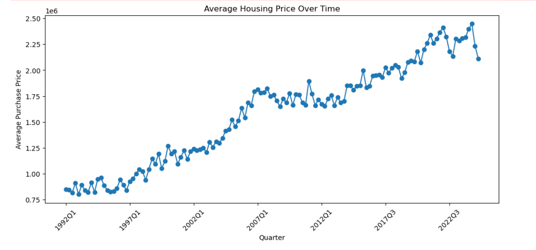
Housing Price Trends Over Time

Slide 44
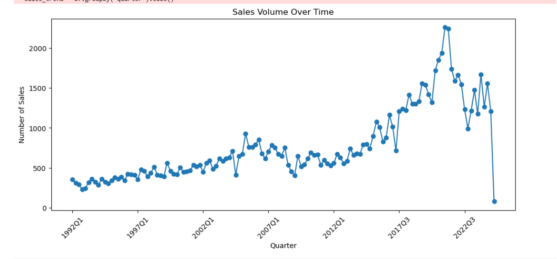
Housing Price Trends Over Time

Slide 45
Housing Price Trends Over Time
Findings
Prices fluctuate across time.
Regional trends differ.
Sales volume changes seasonally.
Conclusion
Housing markets are dynamic and influenced by time.

Slide 46
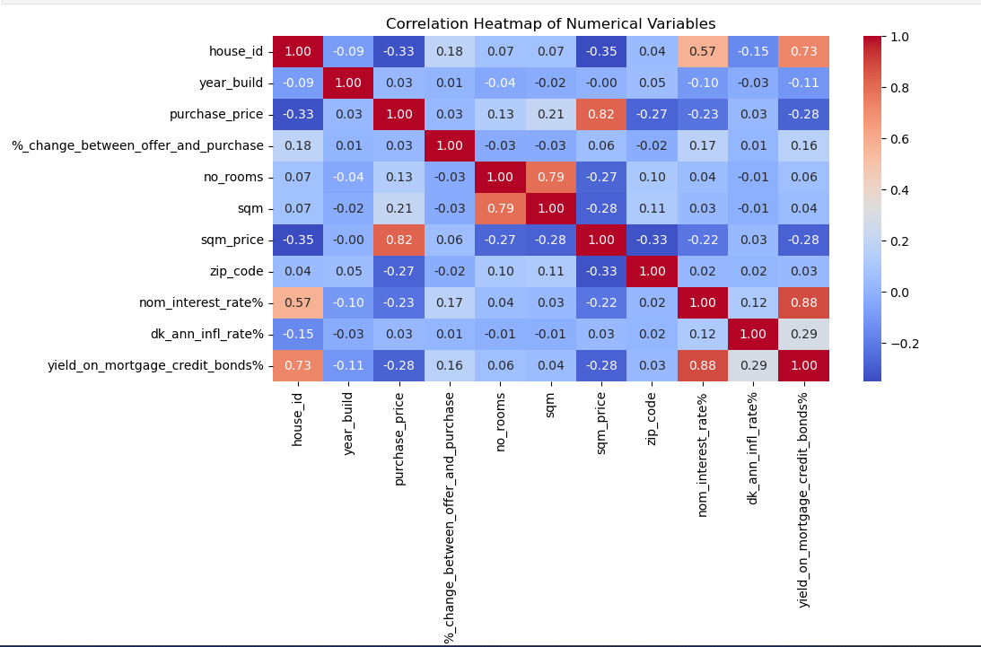
Correlation Analysis

Slide 47
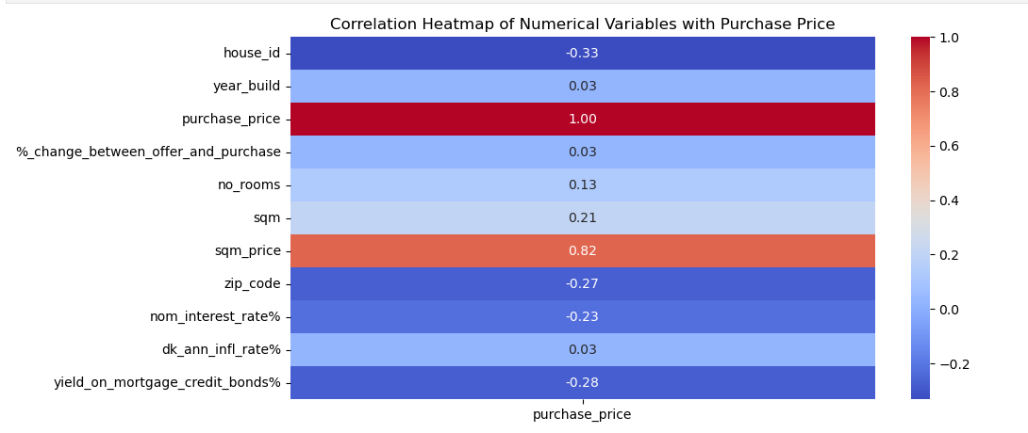
Correlation Analysis with Purchase Price

Slide 48
Correlation Analysis
Findings
Purchase price strongly correlates with property size.
Price per square meter has a moderate relationship.
Some variables have weak correlations.
Conclusion
Property size is among the strongest predictors of housing prices.

Slide 49
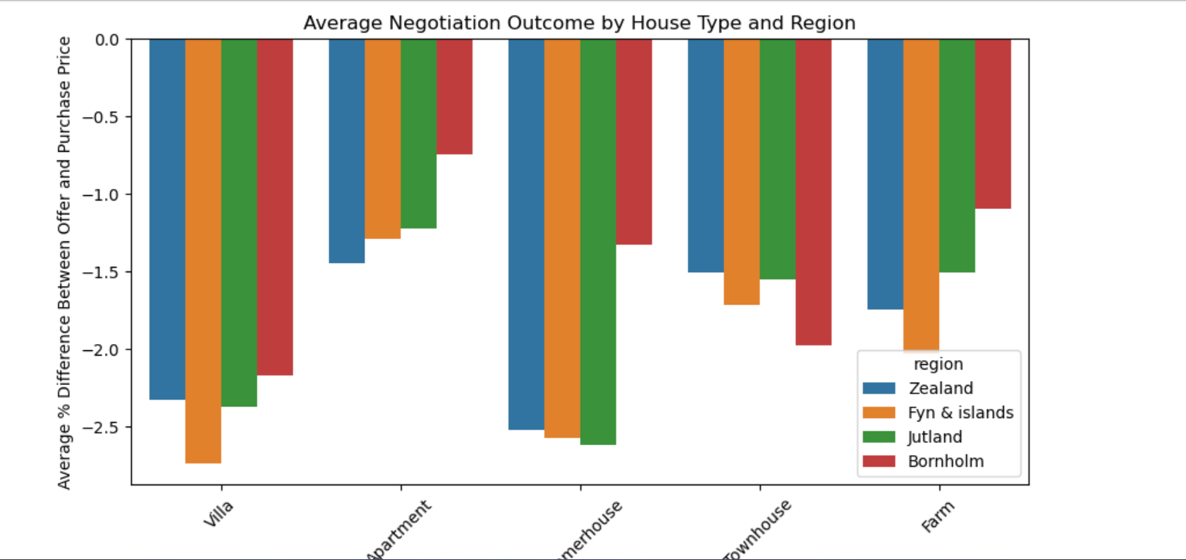
Negotiation Outcomes

Slide 50
Negotiation Outcomes
Findings
Purchase prices are generally below offer prices.
Negotiation differences vary across property types.
Regional differences also exist.
Conclusion
Negotiation outcomes depend on both property type and location.

Slide 51
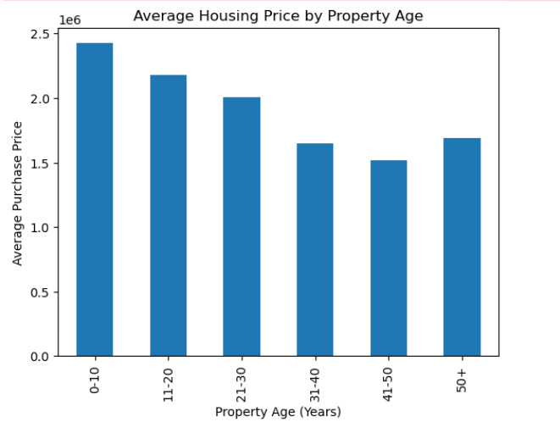
Property Age and Construction Decade

Slide 52
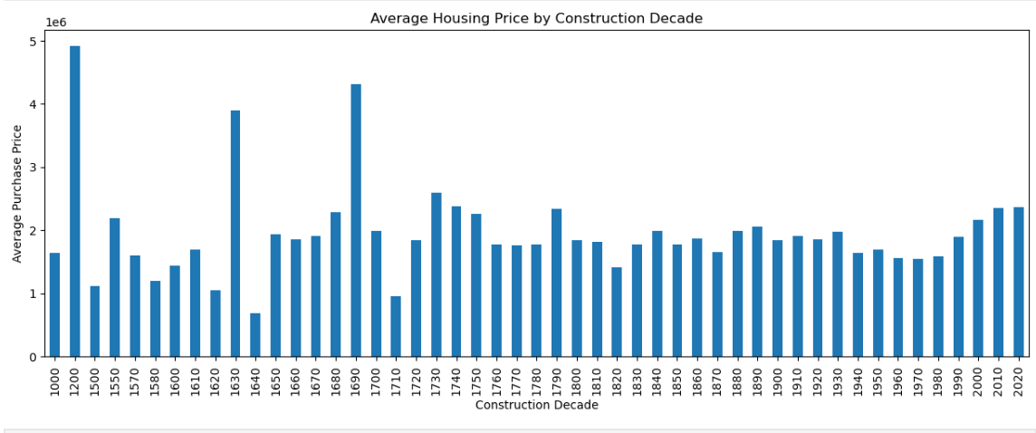
Property Age and Construction Decade

Slide 53
Property Age and Construction Decade
Findings
Newer properties generally have higher average prices.
Housing prices decrease as buildings age.
Some older historic properties remain valuable.
Construction decade influences market value.
Conclusion
Property age and construction period significantly affect housing prices.

Slide 54
KEY FINDINGS
Region strongly influences housing prices.
Property size positively affects purchase price.
Villas are generally more expensive.
Copenhagen remains the most expensive area.
Newer properties command higher prices.
Negotiation outcomes differ across regions.
Construction decade affects valuation.
Exploratory Data Analysis successfully identified market trends.

Slide 55
LIMITATIONS
Dataset limited to available variables.
Inflation was not considered.
Interest rates were excluded.
Economic indicators were unavailable.
Results are limited to the study period.

Slide 56
CONCLUSION
This study successfully applied Exploratory Data Analysis techniques to investigate the Danish housing market.
The analysis revealed that housing prices are influenced by region, property type, property size, negotiation outcomes, property age, and construction decade.
The visualizations and statistical summaries provided meaningful insights that can support informed decision-making for buyers, investors, real estate professionals, and policymakers.

Slide 57
RECOMMENDATIONS
Buyers: Consider older houses for affordability.
Investors: Focus on high-growth regions.
Government: Promote balanced regional development.
Real Estate Agencies: Use market insights for pricing strategies.
Future Researchers: Develop machine learning models for price prediction.

Slide 58
References
Hair, J. F., Black, W. C., Babin, B. J., & Anderson, R. E. (2019). Multivariate Data Analysis (8th ed.). Cengage Learning.
Han, J., Kamber, M., & Pei, J. (2012). Data Mining: Concepts and Techniques (3rd ed.). Morgan Kaufmann.
James, G., Witten, D., Hastie, T., & Tibshirani, R. (2021). An Introduction to Statistical Learning (2nd ed.). Springer.
Tukey, J. W. (1977). Exploratory Data Analysis. Addison-Wesley.
Rosen, S. (1974). Hedonic prices and implicit markets: Product differentiation in pure competition. Journal of Political Economy, 82(1), 34–55.

Slide 59
Thank You!
Thank you for your attention.

